Slide 1
ASSIGNMENT 2
Prudhvi sai suggala 16236300

Slide 2
load('P.mat'),load('T.mat')
[trainP,valP,testP,trainInd,valInd,testInd]=dividerand(P,0.6,0.2,0.2);
[trainT,valT,testT]=divideind(T,trainInd,valInd,testInd);
mse1v = 1;
spread1 = 1.01;
while mse1v >= 0.5
net1 = newrbe(trainP,trainT,spread1); %x is training mse
y1v = sim(net1,valP);
mse1v = mse(y1v-valT) %valiation mse
spread1 = spread1+0.5
end
mse2v = 1;
spread2 = 1.01;
g=0.2;
while mse2v >= 0.5
net2 = newrb(trainP,trainT,g,spread2);%x is training mse
y2v = sim(net2,valP);
mse2v=mse(y2v-valT) %valiation mse
spread2=spread2+0.5
end

Slide 3
y1v= sim(net1,valP);
y1Tr= sim(net1,trainP);
y1T=sim(net1,testP); %simulation of train,test,validate
y2v= sim(net2,valP);
y2Tr= sim(net2,trainP);
y2T=sim(net2,testP);
plotconfusion(trans(valT),trans(y1v),'validation confusion matrix net 1');
plotconfusion(trans(trainT),trans(y1Tr),'train confusion matrix net 1');
plotconfusion(trans(testT),trans(y1T),'test confusion matrix net 1'); %plot confution in graph using plot confusion
plotconfusion(trans(valT),trans(y2v),'validation confusion matrix net 2');
plotconfusion(trans(trainT),trans(y2Tr),'train confusion matrix net 2');
plotconfusion(trans(testT),trans(y2T),'test confusion matrix net 2');
roc1= ezroc3(trans(y1v),trans(valT),2,'RoC Curve-Validation',1);
roc3= ezroc3(trans(y1Tr),trans(trainT),2,'RoC Curve-Training',1);
roc2= ezroc3(trans(y1T),trans(testT),2,'RoC Curve-Test',1);
roc1= ezroc3(trans(y2v),trans(valT),2,'RoC Curve-Validation',1);
roc3= ezroc3(trans(y2Tr),trans(trainT),2,'RoC Curve-Training',1);
roc2= ezroc3(trans(y2T),trans(testT),2,'RoC Curve-Test',1);
function [z]=trans(r)
for k=1:size(r,2)
if (r(k)>=0);
r(k)=1;
else
r(k)=0;
end;
end;
z=r;
end

Slide 4
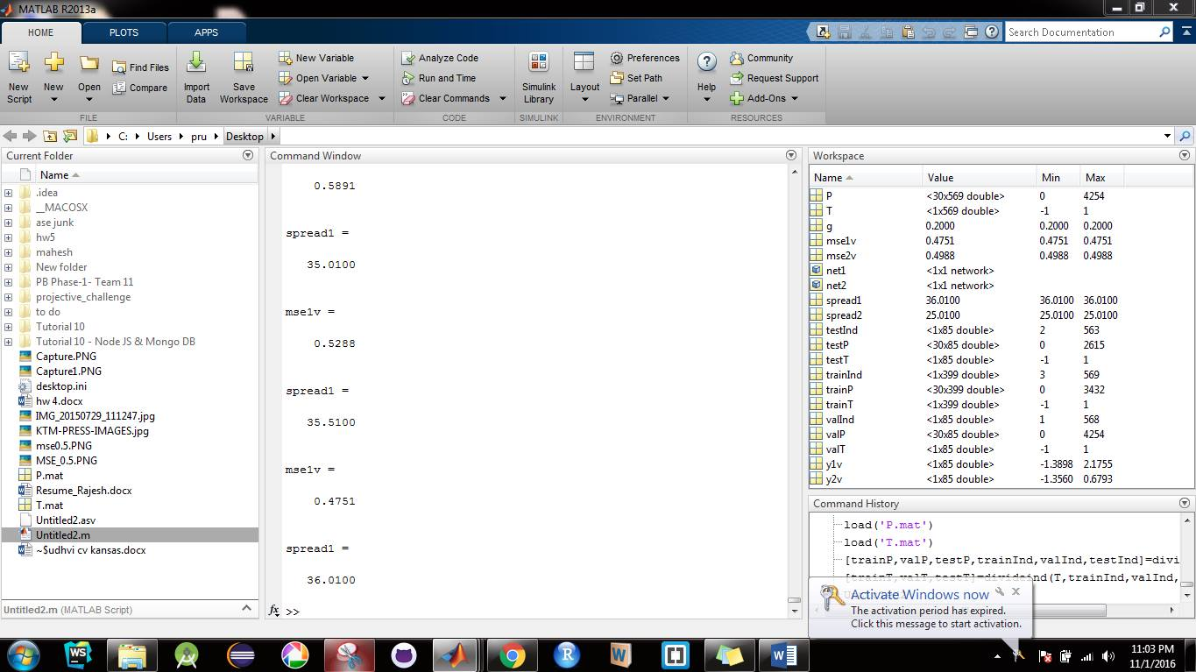
Result using newrbe mse1v =0.4751 for
Spread = 36.01 test_mse=0.369

Slide 5
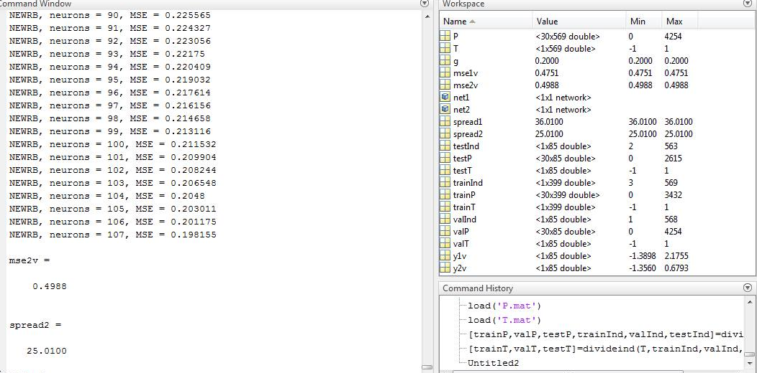
Result using newrb goal=0.2 mse2v =0.4988 for
Spread =25.01 number of neurons =107 mse2test=0.442
Increasing spread to 25.01 for net 2 and 36.01 for net2 helps to classify the problem minimizing the validation mse to 0.5 , If we keep on increasing spread that leads to converge both class hence results in misclassification . Setting goal to 0 do not mean that perfect classifier , seating a reasonable goal also helps in creating a robust classifier

Slide 6
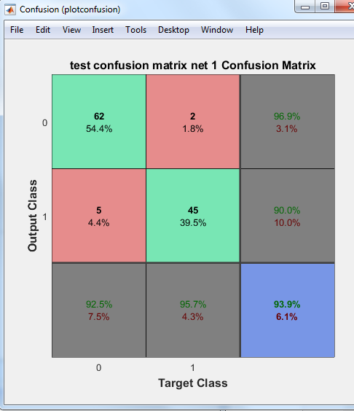
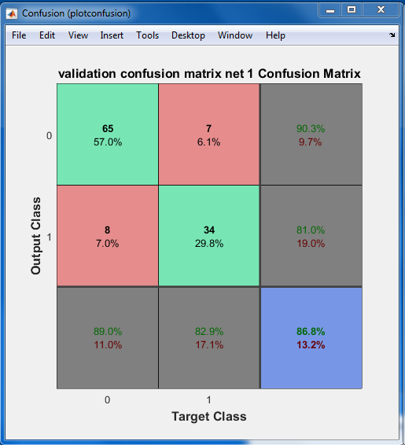
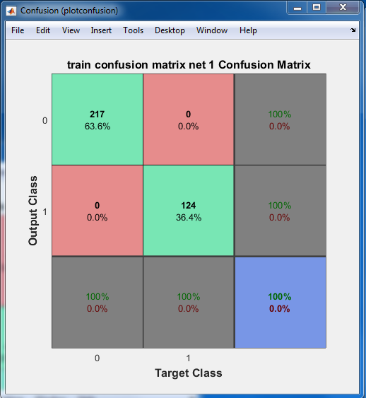
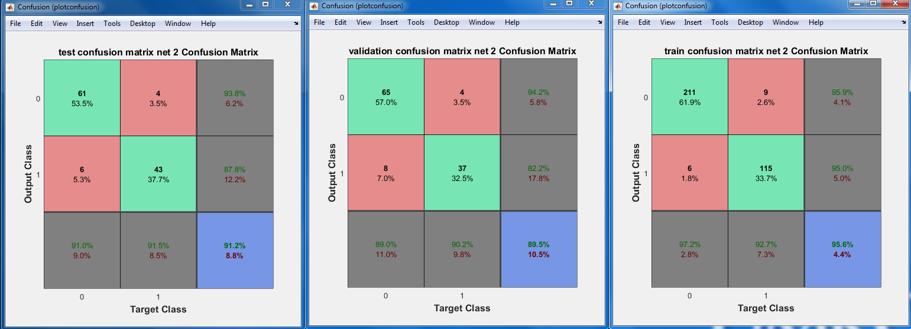

Slide 7
